Slide 1

Factors Influencing Heart Disease Death Rates
Outhai Xayavongsa (Thai) and Aaron Ramirez, Presenters
Notes:
Welcome Everyone! We are diving into Factors Influencing Heart Disease Deaths.
Without further ado, let's get into it!

Slide 2
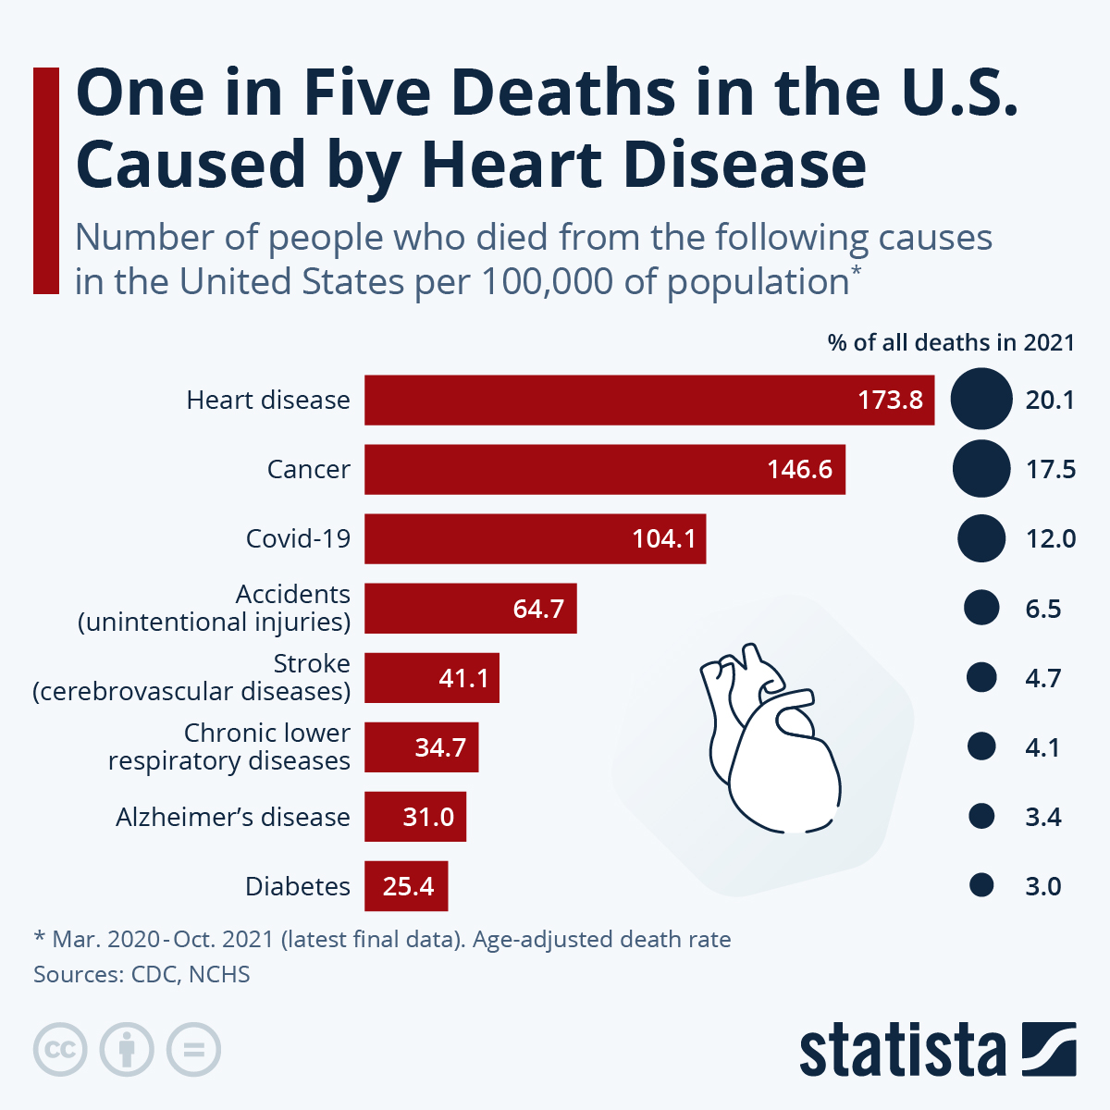
Understanding Heart Disease
# 1 death worldwide
Surpassing Cancer and Covid-19
2021 – 20% of all deaths in the U.S.
Cardiovascular diseases
Acute Myocardial infarction
Coronary Heart disease
Heart Failure
Strokes
(One in Five Deaths in the U.S. Caused by Heart Disease, 2024)
(Xu et al., 2022)
Notes:
I want to shed light on a critical issue that affects millions of lives globally: heart disease.
As we delve into this topic, it's crucial to recognize its significance.
Heart disease isn't just a health concern—it’s the #1 death worldwide.
In the United States alone, the numbers are staggering.
Surpassing even cancer and COVID-19 in recent years, heart disease remains a formidable adversary to public health.
In 2021, it accounted for a shocking 20% of all deaths in the United States. Now, that's a statistic we can't afford to ignore.
But what exactly falls under the umbrella of heart disease? It encompasses major cardiovascular diseases such as acute myocardial infarction, coronary heart disease, heart failure, and strokes.

Slide 3
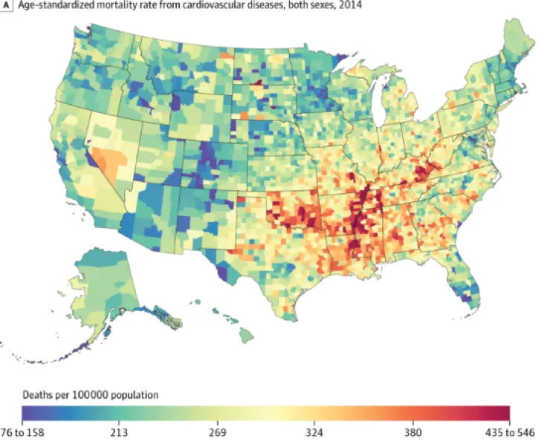
Understanding Heart Disease
35 years+ in the U.S. for 2014
Mortality rates per 100,000 people per county.
Gender, race, and location
Analyze individual-level data
Factors that influence heart disease
(Heart Disease Death Rates Vary Widely Across the US, Map Reveals, 2017)
(U.S. Department of Health & Human Services, 2023)
Notes:
Now, let's shift our focus to a specific data we've gathered.
This data zooms in on heart disease mortality rates among individuals aged 35 and above in the United States for the year 2014.
It provides mortality rates per 100,000 people for each county for individuals dealing with heart disease.
It includes factors such as gender, race, and geographical location for each county.
Through our research, we hope to raise awareness of how these factors can influence an individual's susceptibility to heart disease and ultimately, mortality outcomes.
In essence, this research isn't just about numbers—it's about people.
It's about uncovering insights that can pave the way for targeted interventions and ultimately save lives.

Slide 4
- Geographical Location – County / State - Ethnicity/Race –White, Black, Hispanic, American Indian and Alaskan Native, and Asian and Pacific Islander - Gender – Male vs Female
Factors that Impact of Location, Ethnicity, and Gender
Notes:
We want to investigate why some people are more likely to die from heart disease than others. To do this, we'll look at three main factors:
Geographic Location: We'll examine whether heart disease death rates differ depending on where people live, focusing on counties within states.
Ethnicity/Race: We'll analyze how belonging to different ethnic groups—such as White, Black, Hispanic, American Indian and Alaskan Native, and Asian and Pacific Islander—affects the likelihood of dying from heart disease.
Gender: We'll explore whether being male or female influences the risk of death from heart disease.
Understanding how these factors interact can help us identify patterns and develop strategies to reduce the risk of heart disease and improve overall health outcomes.

Slide 5

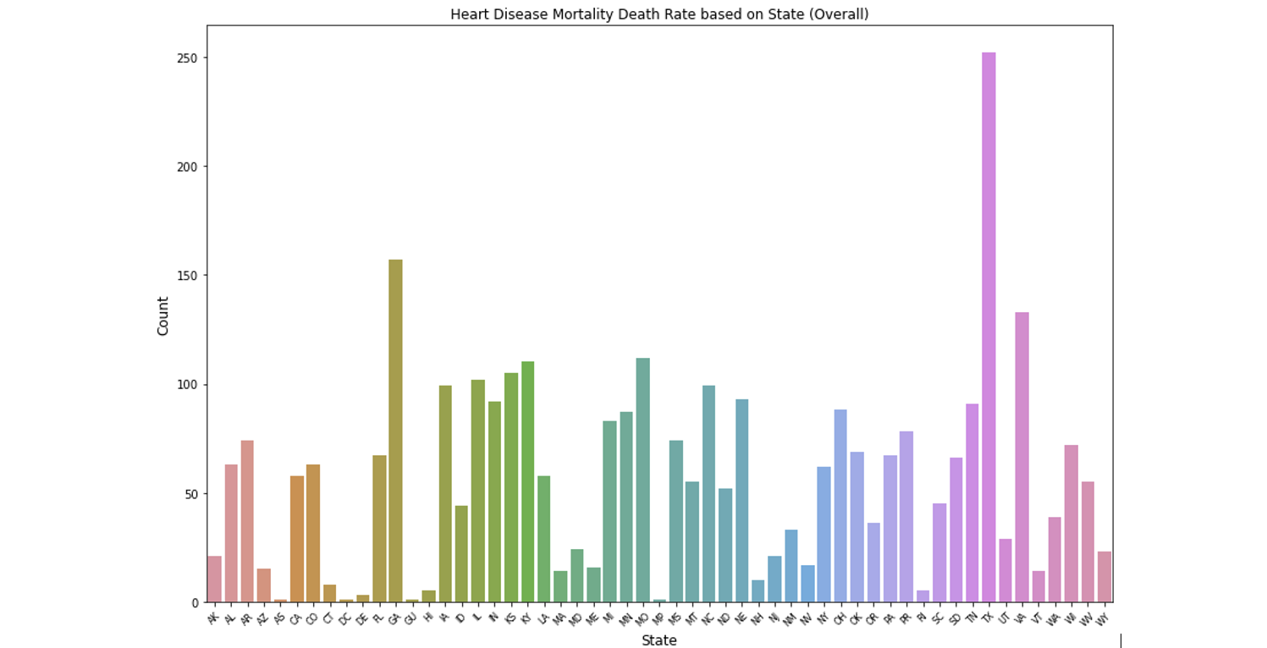


What are the influential factors of heart disease within the states?
Heart disease by states
Tall = more deaths
#1 Texas
#2 Georgia
Lowest = Hawaii & Delaware
Influential factors
Healthcare
Income
Lifestyle
Resources
Etc.
(Kreatsoulas & Anand, 2010)
Figure 1: Bar Graph of Heart Disease Mortality Death Rate on State (Overall)
Notes:
Let's look this bar chart showcasing the differences in heart disease death rates across the nation in the U.S.
This will help us grasp how heart disease varies state to state. As we zoom into different states, we'll notice variations in these rates.
Each bar represents a state, and the height of the bar shows how many people have died from heart disease in that state.
The taller the bar, the more deaths there have been. For instances Texas ranks number one with the highest heart disease deaths and coming in second is Georgia.
On the opposite end with the lowest heart disease deaths is Hawaii and Delaware.
We must determine which factors contributed to these extremes.
We need to determine if this information influenced by the quality of healthcare, income, lifestyle choices, resources available., or etc.

Slide 6
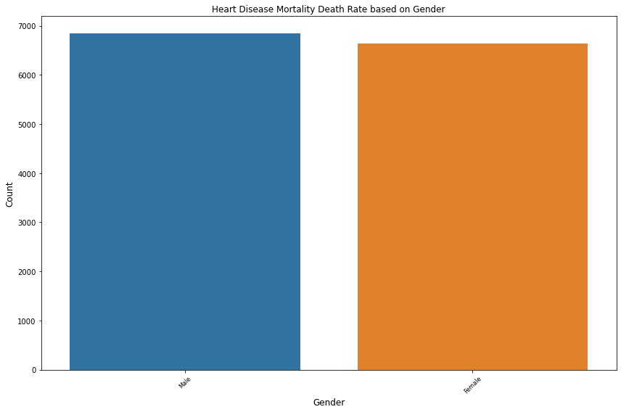
Heart Disease mortality between Males vs. Females
Males and Females about the same height
Heart disease is unbiased
Risk are different
Men
Lower estrogen
More alcohol
More stress
Less doctors visits
Women
Menopause
Less Estrogen
Autoimmune disease
High Depression & Anxiety
(Jhalani, 2022)
Figure 2: Bar Plot of Heart Disease Mortality Death Rate based on Gender
Notes:
We'll investigate the mortality rates due to heart disease and discuss the balance in representation between genders.
Look at this bar graph. You see two bars – blue representing males and orange representing females.
What's noteworthy here is the balance; the bars are almost the same height.
This means we have nearly an equal number of men and women in our data, giving us a clear, UNBIASED view of how heart disease impacts both genders.
Now, although our data seems well-balanced, it doesn't mean that the risks are the same.
Men and women can experience different symptoms, risk factors, and even outcomes when it comes to heart disease.
Studies show that men who have lower levels of estrogen could be a factor. Men are more likely to drink alcohol, they experience more stress, and less likely to visit the doctors.
For females, some factors may include menopause and a reduction of estrogen levels. Women are more susceptible to autoimmune disease and high rate of depression and anxiety which are contributing factors for an increase in heart disease.

Slide 7
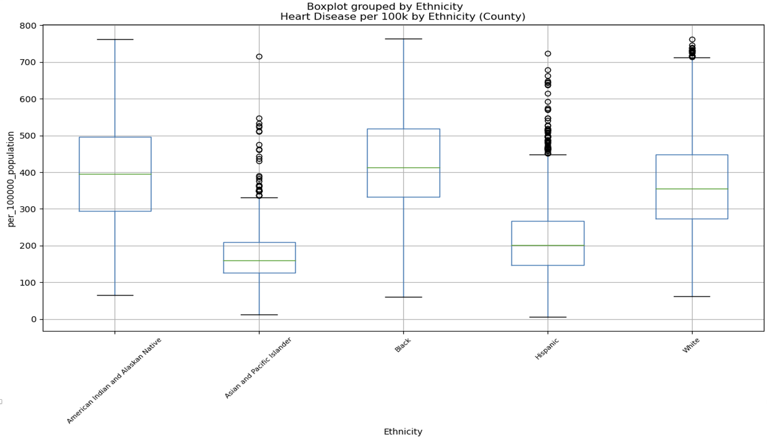
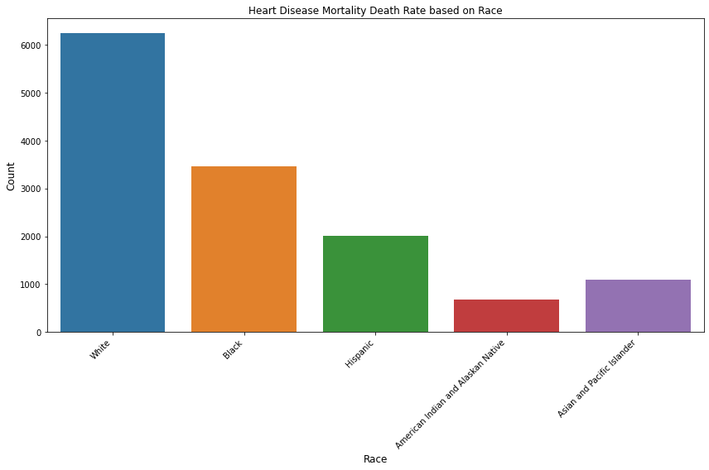
What are the impacts on Race/Ethnicity on Heart Disease?
Box Plot
Bar Graph
Factors:
Healthcare?
Lifestyle?
Genetics?
Highest average deaths
* Blacks
Highest # of deaths
Whites
Lowest # of deaths
* American Indian and Alaskan Natives
Figure 3: Box Plot of Heart Disease Death by Ethnicity based on County
Figure 4: Bar Graph of Heart Disease Mortality Death based on Race
Notes:
Boxplot
In the visual to the left, we call this a boxplot, we're looking at boxes that represent the range of heart disease death rates for different ethnic groups.
The middle line is the middle where most people fall—it's the average rate for that ethnic group. The group who has the highest average, has the most deaths due to heart disease.
Sometimes you'll see dots above or below the boxes. We call these outliers. These represent rates that are much higher or lower than most of the others—they're the exceptions to the rule.
We need to know what factors affect heart disease. Is it healthcare, specific lifestyle choices, or genetic predispositions?
Bar Graph
Now looking at the right, The tallest bar, had the highest number of cases representing whites.
On the other end of the spectrum, the shortest bar corresponds to American Indian and Alaskan Native.
This visual comparison makes it clear that heart disease does not impact all communities equally, and some groups may need more targeted health interventions and resources to reduce their risk.
This method is a common practice in research to help identify disparities and potential factors contributing to differences in health outcomes across racial lines.

